Slide 1



Analyzing eCommerce Business Performance with SQL
Created by:
Kenneth Wahyudi, S.Si.
kennethwahyudi48@gmail.com
https://www.linkedin.com/in/kenneth-wahyudi-80b886209/
I am an aspiring data scientist with interest in machine learning and paddling through the data lake. I have experiences as a research intern in BATAN, and several data science and machine learning projects under my belt. Specifically intermediate to advanced knowledge in Exploratory Data Analysis, Data Pre-processing, Supervised & Unsupervised Learning, as well as Data Visualization and Storytelling. And I am always looking forward to exploring new and uncharted territories that might allow myself to grow and improve.

Slide 2
Overview

Slide 3
Overview
In a company, measuring business performance is of utmost importance to track, monitor, and assess the success or failure of various business processes. Therefore, this paper will analyze the business performance of an eCommerce company, taking into consideration several business metrics, namely customer growth, product quality, and payment methods.
All results are outputs from queries executed in PostgreSQL’s management tool Pg Admin 4.
Link to the datasets used in this project can be found here :
https://drive.google.com/drive/folders/1PCdSDyv1dYNZYDmznSKVUgfl0jhP1Zyq?usp=sharing

Slide 4
Data Preparation

Slide 5
Data Preparation
I first created a database in the Pg Admin 4 named ‘ecommerce’. Then, create 8 tables from the datasets : customers_dataset.csv, geolocation_dataset.csv, order_items_dataset.csv, order_payments_dataset.csv, order_reviews_dataset.csv, orders_dataset.csv, product_dataset.csv, sellers_dataset.csv. With the product_id column from the product_dataset table as a primary key, the order_id column from the orders_dataset table as a primary key, the seller_id column from the sellers_dataset table as a primary key, and the customer_id column from the customers_dataset table as a primary key.
Looking at the relationship requirement between the tables, the zip_code_prefix column in the geolocation_dataset table needs to be unique in order to establish the proper relationships. However, the column contains duplicate values. And not only that, some zip_code_prefix values from the sellers_dataset and customers_dataset tables do not exist in the zip_code_prefix column within the geolocation_dataset table. Therefore, data cleaning must be performed that inputs the non-existing zip_code_prefix values into the geolocation_dataset table, and then dropping the duplicate values so that each and every value within the zip_code_prefix column in the geolocation_dataset table is unique. And finally setting that column as a primary key.

Slide 6
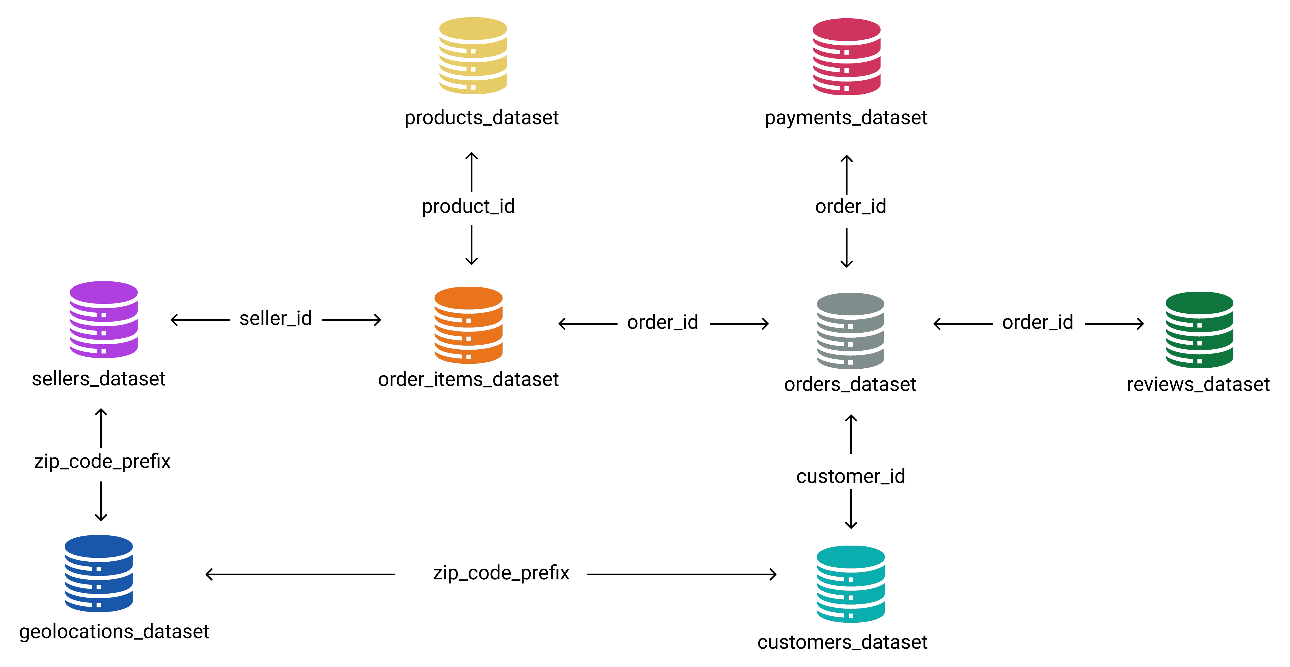
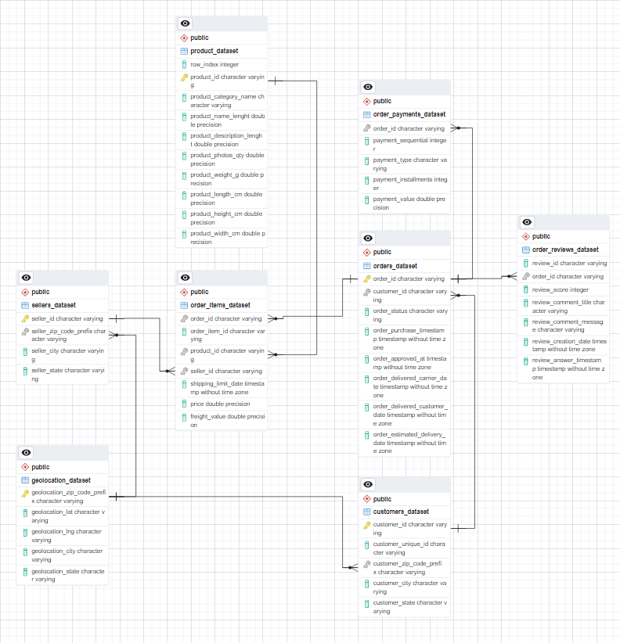
Data Preparation
After all that, only then can I create the relationships by establishing a foreign key constraint into the corresponding tables. By obeying the relationship requirement on the left, I created the Entity Relationship Diagram (ERD) using Pg Admin 4 on the right :
The complete query, ERD in png format, and ERD in
pgerd format can be accessed in the following link : https://drive.google.com/drive/folders/1jT952KR6TyS2r56I1UTezjyxUOfo9dCq?usp=sharing

Slide 7
Annual Customer Activity Growth Analysis

Slide 8
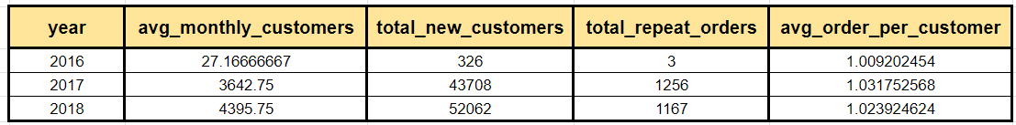
Annual Customer Activity Growth Analysis
Above is the table that is as a result of 5 steps of queries :
Displaying the average monthly customers per year
Displaying the number of new customers per year
Displaying the amount of customers that do repeat orders per year
Displaying the average orders per customer each year
Joining to create a master table that houses all the information

Slide 9
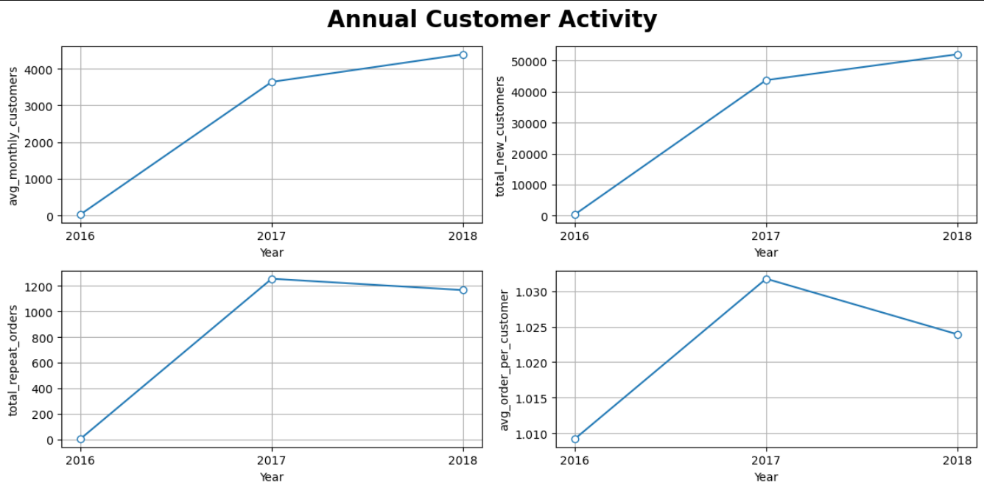
Annual Customer Activity Growth Analysis
As you can see from the chart on the left, all of the variables follow a similar trend. With average monthly customers & total new customers are on the rise, but their ascent is slowing down. However, for the total repeat orders & average order per customer, everything seems to be the same until the year 2017. When the numbers actually decline, with average order per customer actually declining quite steeply.
Further analysis should be done on the latter two, as to why they are on the decline. And prescriptive efforts may have to be implemented in order to increase the values in those two aspects such as a better recommender system, discounts & sales, targeted marketing, etc.
The complete query in doc format, output file in csv format, and chart in png format can be accessed in the following link :
https://drive.google.com/drive/folders/1d0O4lsOrMRaIpWaPhYPMYf6A04qK9YHY?usp=sharing

Slide 10
Annual Product Category Quality Analysis

Slide 11

Annual Product Category Quality Analysis
Above is the table that is as a result of 5 steps of queries :
Displaying the total revenue each year
Displaying the total number of canceled orders each year
Displaying the categories that brings the most revenue each year
Displaying the categories that has the largest number of canceled orders each year
Creating a master table (the table above) that houses all of the information from the above steps of queries.
The complete query in doc format, charts in png format, and table in csv format can be accessed in the following link :
https://drive.google.com/drive/folders/1WyUMh8CJ1qyQxotyuSGY657Dl6KSa2PA?usp=sharing

Slide 12
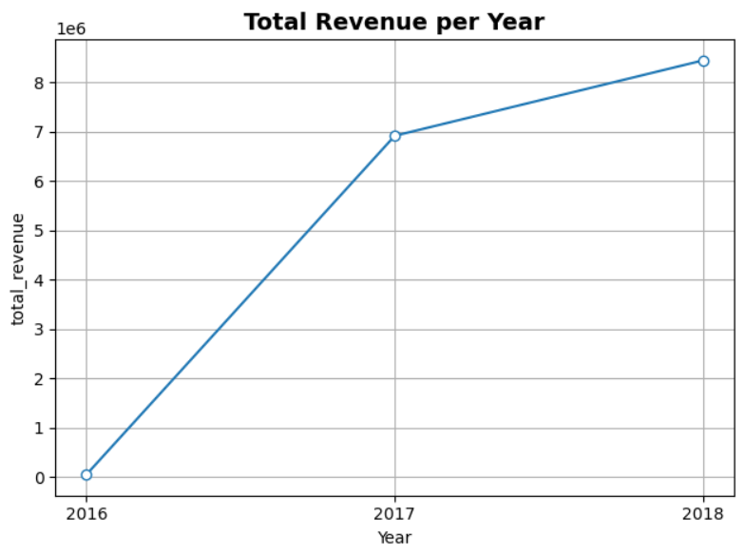
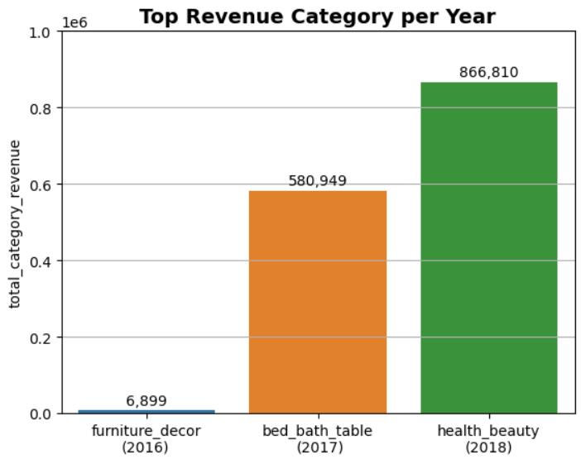
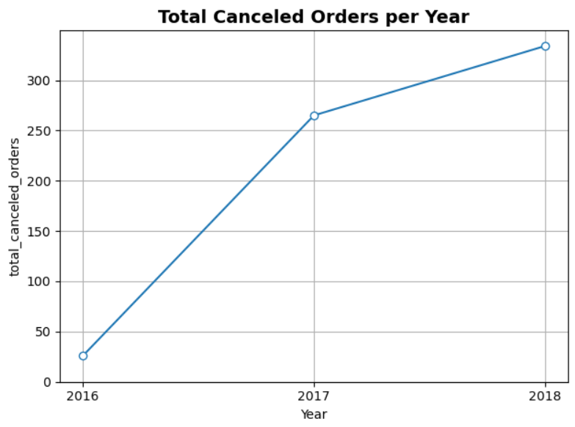
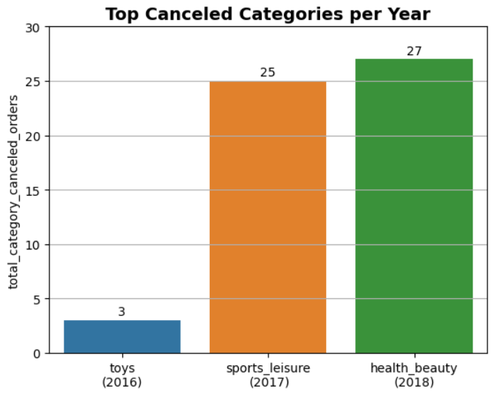
Annual Product Category Quality Analysis
From the total revenue chart, we can see that the yearly revenue sky-rocketed in 2017. However, that growth slows down significantly in 2018. The same goes for the amount of canceled orders. With more orders resulting in more canceled orders, visible in the spike in 2017. Top revenue category & Top canceled category follow the same trend. However, in 2016 & 2017, the top revenue category is different than the top canceled category. Which may suggest that the top revenue category in those years were performing relatively well compared to the top revenue category in 2018.

Slide 13
Analysis of Annual Payment Type Usage

Slide 14
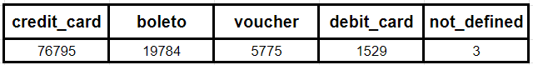
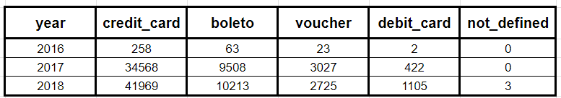
Analysis of Annual Payment Type Usage
Below is the table that displays the amount of usage per each payment_type :
Below is the table that displays the amount of usage by each payment_type per year :

Slide 15
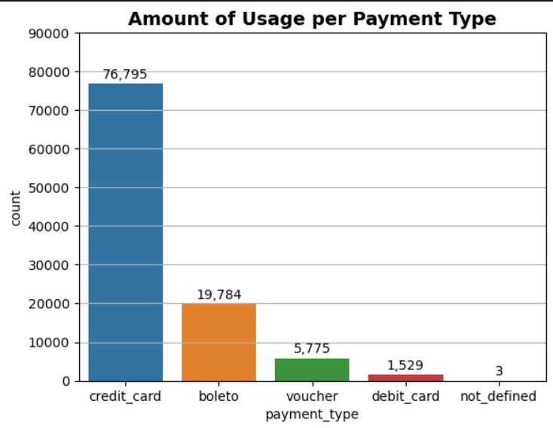
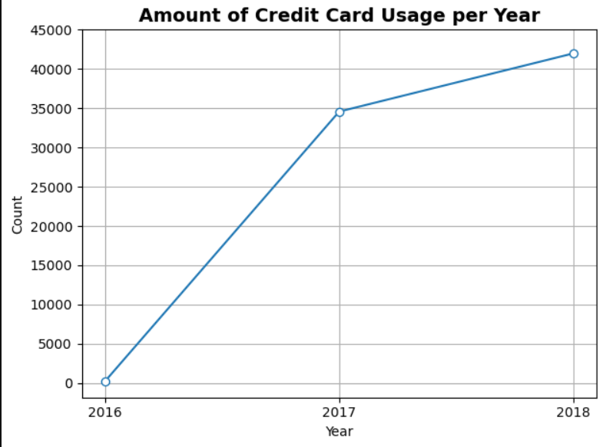
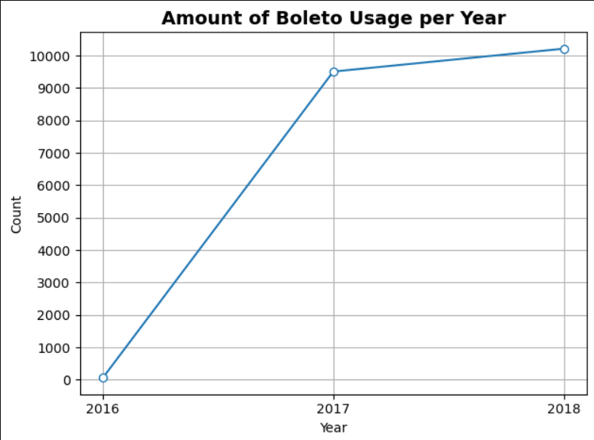
Analysis of Annual Payment Type Usage
From the chart above, we can see that credit card is by far the most popular method of payment. And in the other charts, we can see that not only is credit card the most popular method, but its growth is also the quite promising. With its growth from 2017 to 2018 being a lot better than boleto that slows down after 2017.

Slide 16
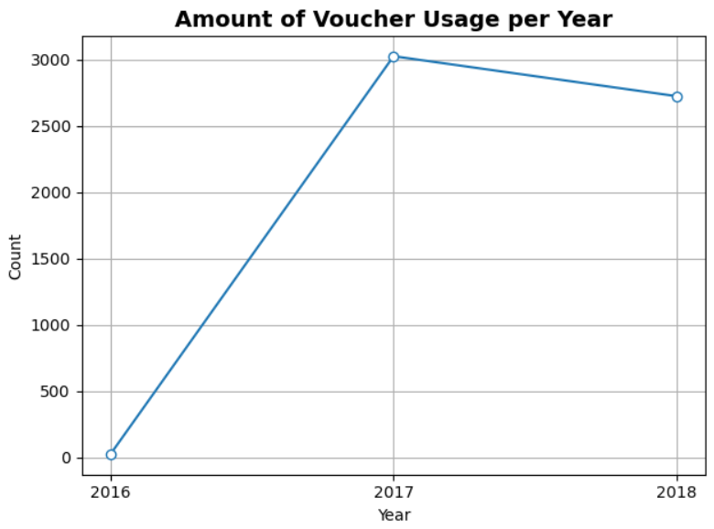
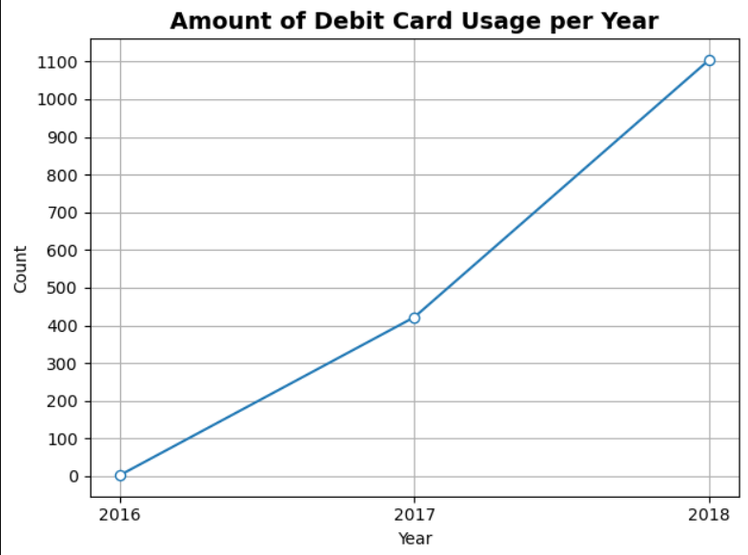
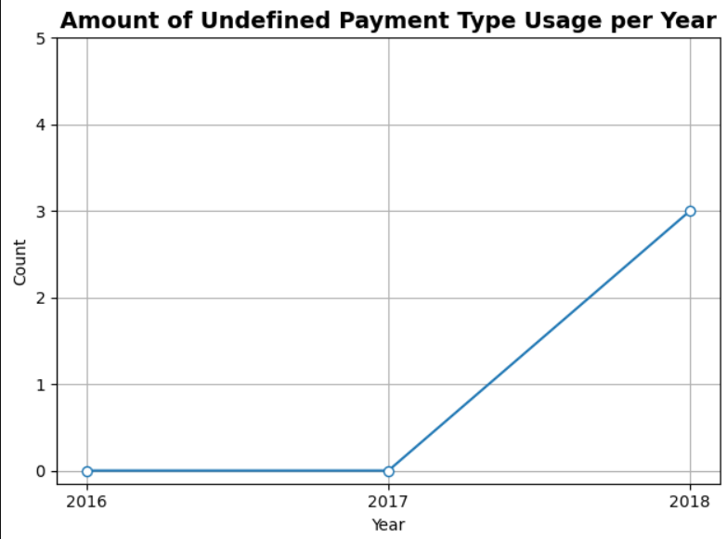
Analysis of Annual Payment Type Usage
From the charts above, it is visible that the voucher payment type is in decline after the 2017 growth boom. Whilst the growth of the usage of debit cards are the best compared to all the other payment types. One interesting note is that in 2018, there are 3 orders with undefined payment types. It is possible to investigate further what kind of payment type it is, especially if it grows exponentially in the following years, being a significant player in the game.
The complete query in doc format, charts in png format, and output tables in csv format can be accessed in the following link :
https://drive.google.com/drive/folders/1ycToT7_-QCo9QQ11w75aaYNHHABRm4sG?usp=sharing

